Slide 1
Sensor-based prototype for license plate detection and recognition in an urban limited traffic zone
Team:
Albertazzi Riccardo
Andraghetti Lorenzo
Berlati Alessandro
Corni Gabriele

Slide 2
Scenario description
Urban limited traffic zone
Various access gates
White list of authorized plates
Different categories of vehicles (with different authorization access)
Resident cars, taxis, public transport, emergency vehicles (24/7)
Private cars (not authorized)
Motorbikes (24/7)
…
Possibility to buy a time-limited authorization ticket
1 hour
1 month
…

Slide 3
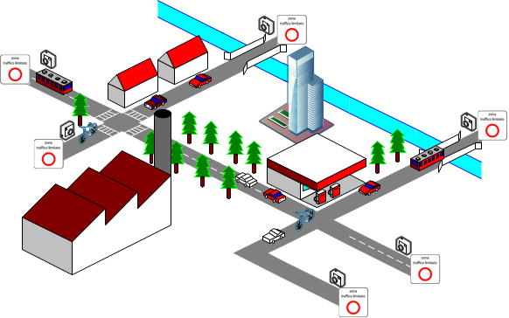
Scenario diagram

Slide 4
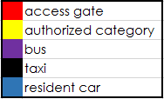
Scenario diagram
UNAUTHORIZED ACCESS

Slide 5
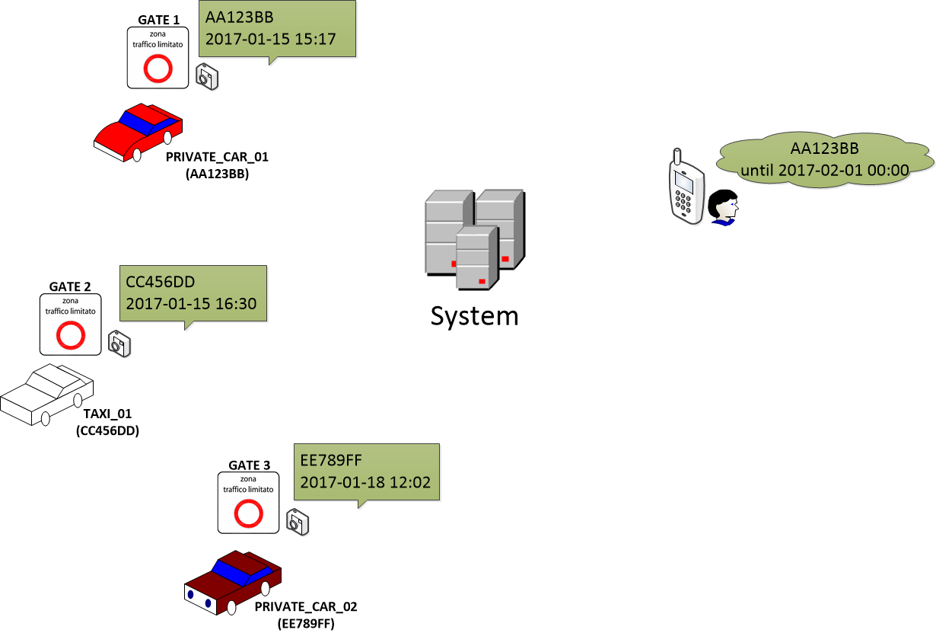

All-in-one the «big picture»
DATA
OK
DATA
DATA
OWNER_01 OK
OK
FINE TO OWNER_02
DATA
NO!!!
The owner of PRIVATE_CAR_01 is the only one who purchased an access ticket

Slide 6
Scenario workflow
The system comes with a pre-loaded white list of authorized plates with 24/7 granted access (eg: actual resident cars, taxis, buses, …).
The system is linked to the Vehicle Registration Institution (Motorizzazione Civile) and knows the bindings among every existing plate and its owner’s personal details.
Every client can buy a pass for entering the zone. Each pass includes an access ticket with a certain duration. Using the proper mobile app, it’s possible to bind a plate to the purchased ticket. Once the registration is completed, the registered vehicle can enter the zone untill the ticket expires.
Every access gate has a camera sensor that monitors in real time the vehicles entering the limited traffic zone. If a vehicle pass, its plate is detected and researched inside the white list: if a match isn’t found (unauthorized access detected), the system sends a fine to the owner.
Some categories of vehicles (eg: motorbikes) can enter the zone without permission.

Slide 7
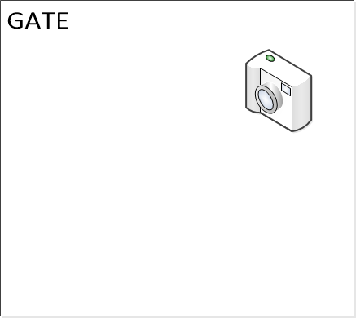
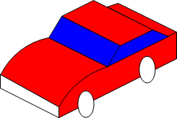
Lab. example
1
2
111
222
Entering
camera sensor
Entering
camera sensor
Sensor data

Slide 8
Lab. example
1
2
111
222
Entering
camera sensor
Entering
camera sensor
Sensor data

Slide 9
Lab. example
Smartphone + Mobile app
New ticket registered

Slide 10
Lab. example notes
An FPGA module with a connected camera module is suitable for process incoming plate’s data.
For an optimal data processing, both motion detection and OCR are needed.
Our FPGA’s software can only recognize few specified images within a video stream: the board hasn’t enough computational resourses for handling the whole process.
For these reasons, in this lab. example we have used a Java simulator interface instead of the real FPGA.
The Android mobile app, on the other hand, has been concretely implemented.

Slide 11
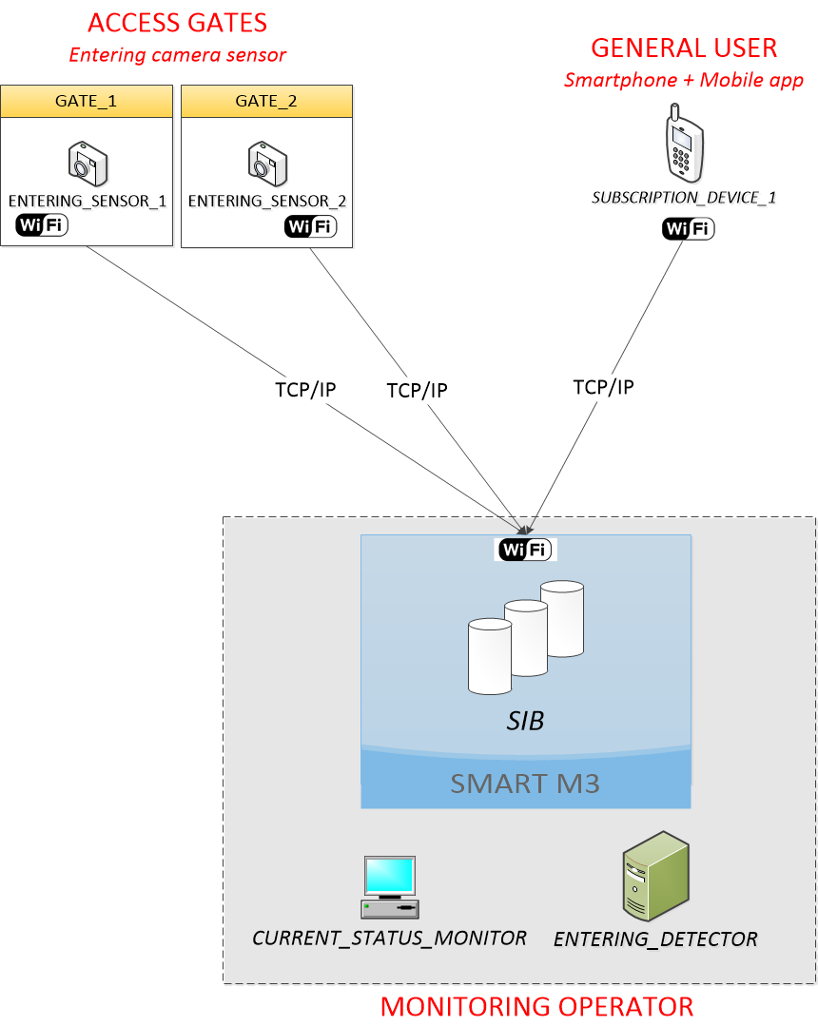
HW architecture

Slide 12
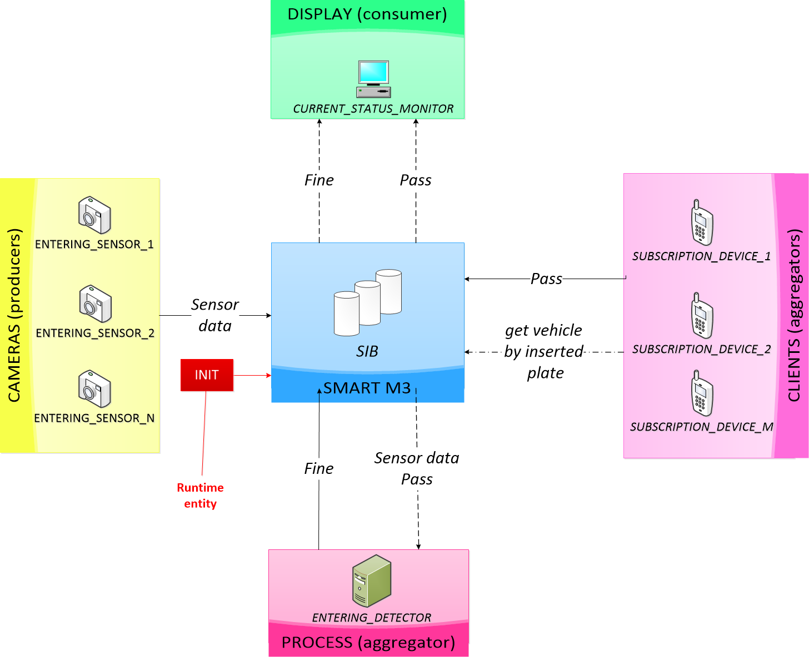


SW architecture

Slide 13
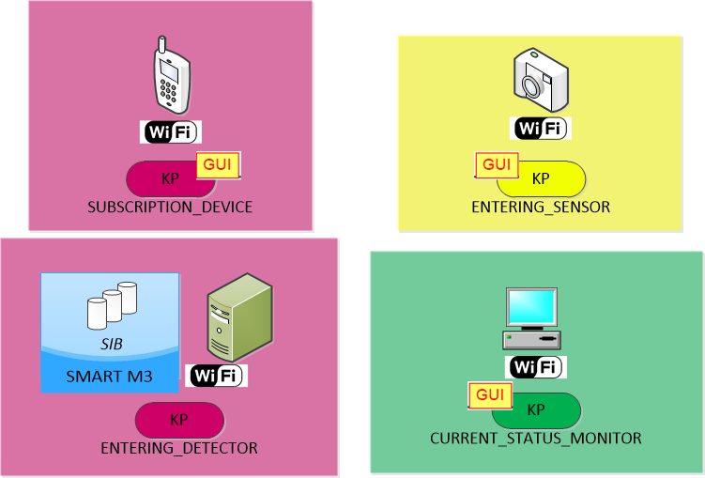
HW/SW architecture

Slide 14
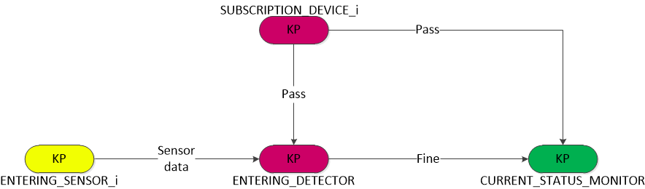
Data flow

Slide 15
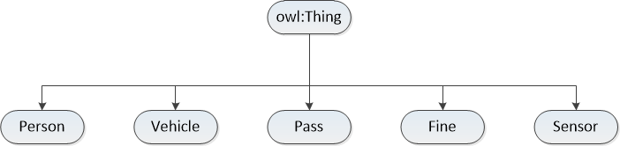
Reference ontology class tree

Slide 16
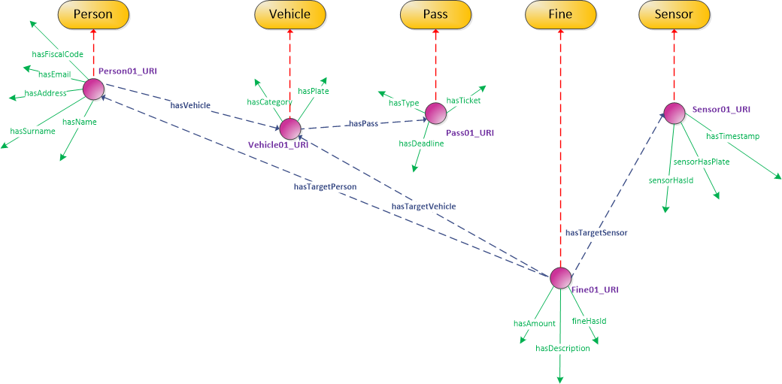
Ontology awareness
«ABCDEF55X31P784P»
«nc@gmail.com»
«Taxi»
«AB123CD»
111
«daily»
«Trafalgar Square»
«Smith»
«John»
2017-01-15
2017-01-18
«AB123CD»
2
50
1
«Unauthorized access»

Slide 17
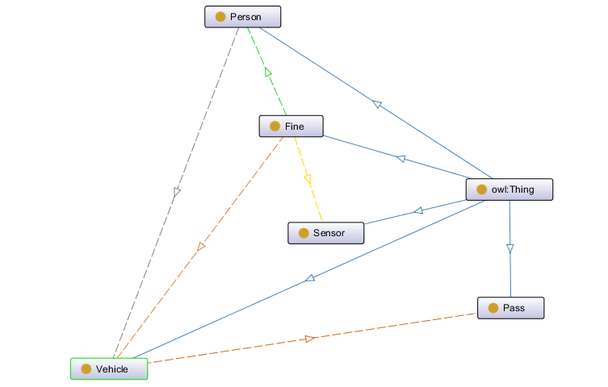
Ontology graph

